Slide 1
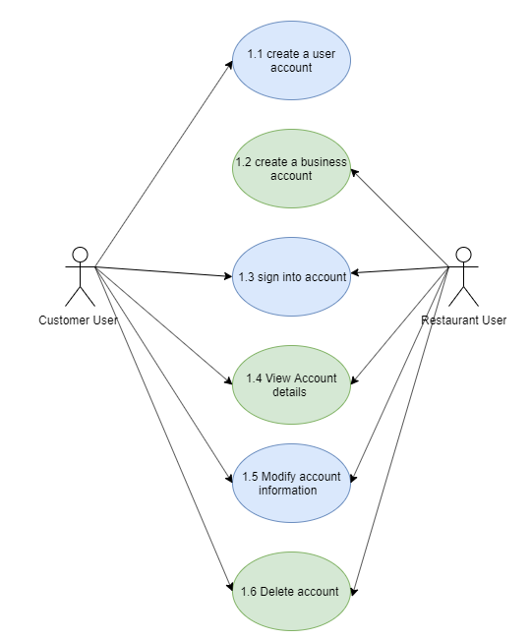
Use Case Diagram
Super Servoli Systems
Use Case Diagram
Module: 01. User's Account

Slide 2
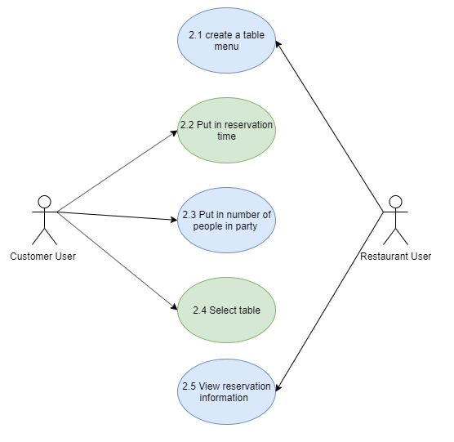
Use Case Diagram
Super Servoli Systems
Use Case Diagram
Module: 02. Reserve Table

Slide 3
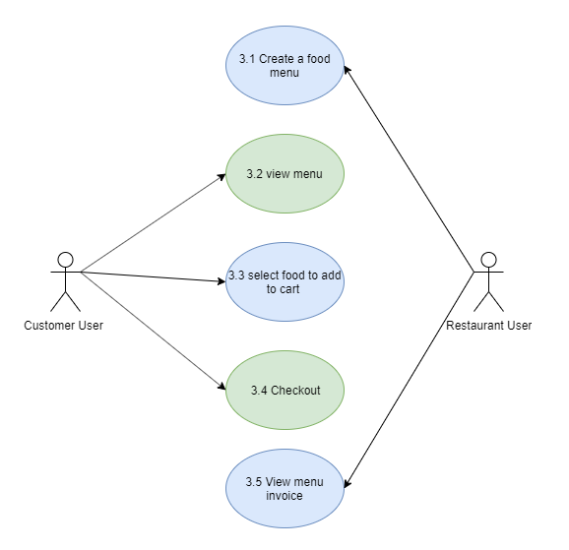
Use Case Diagram
Super Servoli Systems
Use Case Diagram
Module: 03. Restaurant Menu

Slide 4
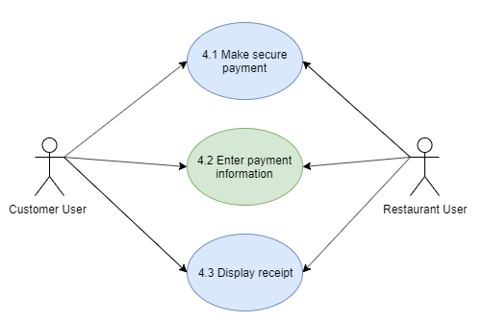
Use Case Diagram
Super Servoli Systems
Use Case Diagram
Module: 04. Payment

